Slide 1
School of Geography and Geology
McMaster University
Applied Spatial Statistics
Spatially Continuous Data
I & II

Slide 2
This session:
Spatially Continuous Data I & II
  Definitions
  Visualization
  Exploration:First Order Properties
    Moving Averages
    Kernel Estimation
    Tesselation Methods
  Exploration: Second Order Properties
    Covariogram and Variogram

Slide 3
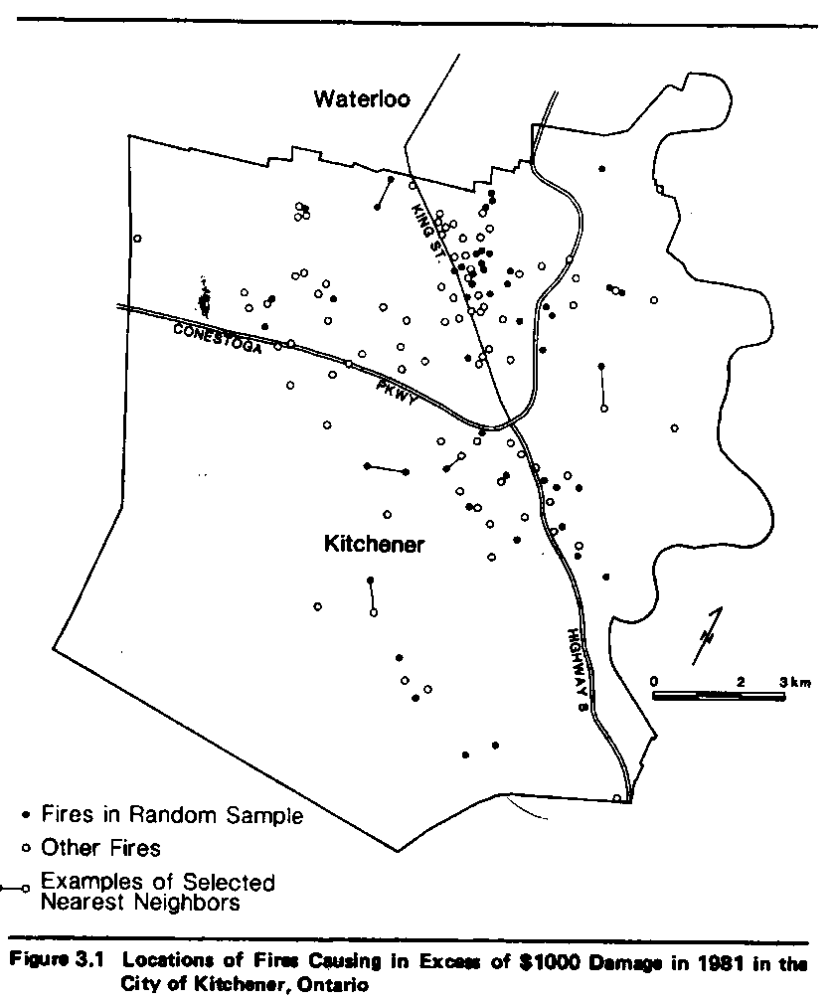
The difference between point patterns and spatially continuous data
Location of fires in Kitchener, Ontario

Slide 4
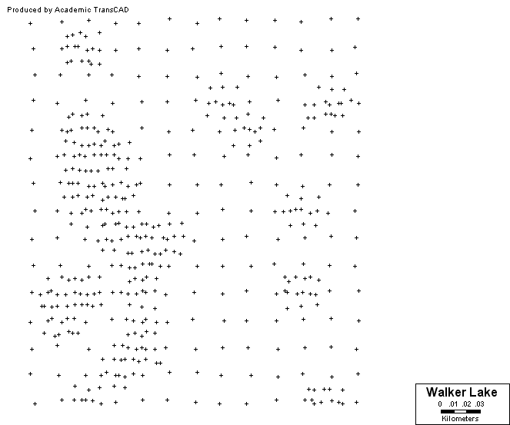
The difference between point patterns and spatially continuous data
Concentration of a contaminant in ppm

Slide 5
The difference between spatially continuous data and area data
Time series
Temperature
Interest Rates
Temperature
Interest rates
Time
Time

Slide 6
Scale of Analysis

Slide 7
Examples of Applications
In the environmental sciences
  Ore grades in a mineral deposit
  Depth and thickness of a geological layer
  Density of trees of a certain species in a forest
  Soil properties in a region
  Rainfall over a catchment area
  Pressure, temperature and wind velocity
  Piezometric-head data

Slide 8
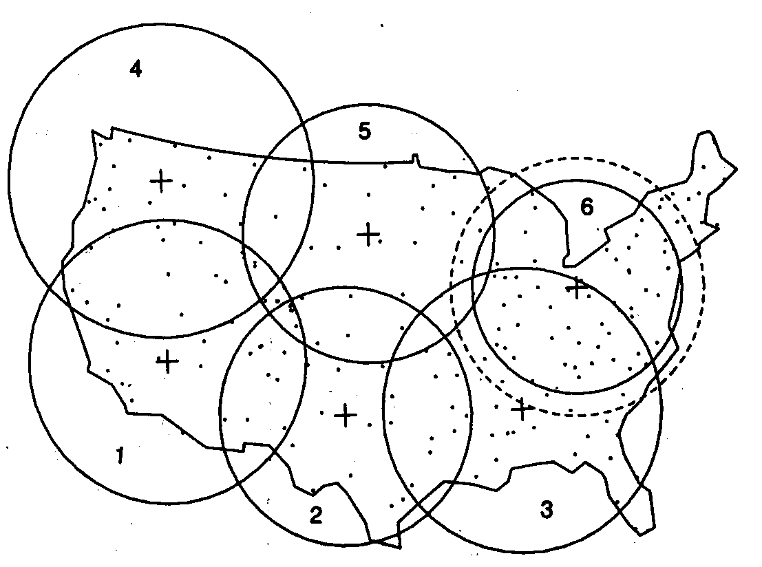
US NADP/NTN*: Stations in the US
*National Atmospheric Deposition Program/
National Trends Network

Slide 9
US NADP/NTN: Stations in the US
Damage to environments from acid rain
Forest effects: die-off of trees at high elevations
Long term effects on the growth of commercial stands

Slide 10
Examples of Applications
In the social sciences
  Land values
  House prices?
  Personal income?

Slide 11
Goals of Applications
The description of important features
Estimation of an average value over large areas
The estimation of an average value over small areas
Estimation of an unknown value at a particular location
(first order and second order effects)

Slide 12
Goals of Applications: PP
The description of important features
The identification of clustered, random or regular patterns
(first order and second order effects)

Slide 13
Spatially Continuous Data
Visualization
  Proportional symbol maps
  Triangulated irregular networks (TIN)
Exploration

Slide 14
Definitions
Region
Location
Attributes
Observation
First order effects
Second order effects

Slide 15
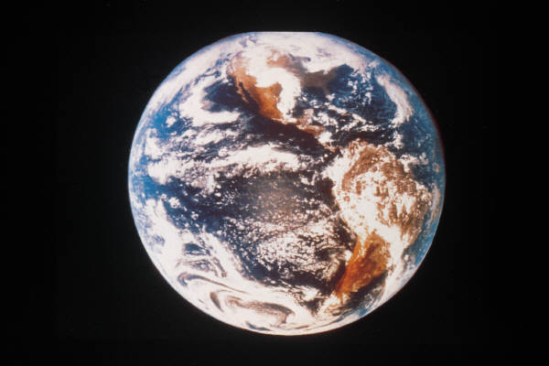
Definitions: Region
Region (R) – Specific area over the surface of the earth that is of interest

Slide 16
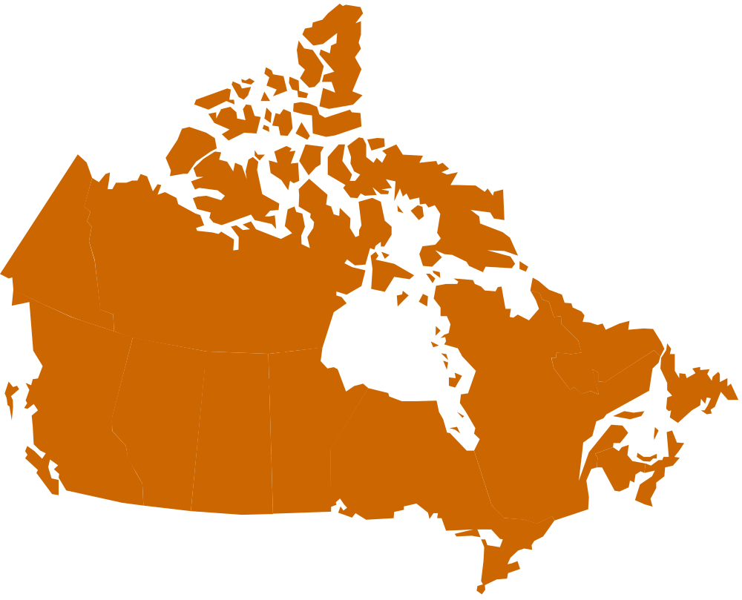
Definitions: Region

Slide 17

Definitions: Region

Slide 18

Definitions: Region

Slide 19
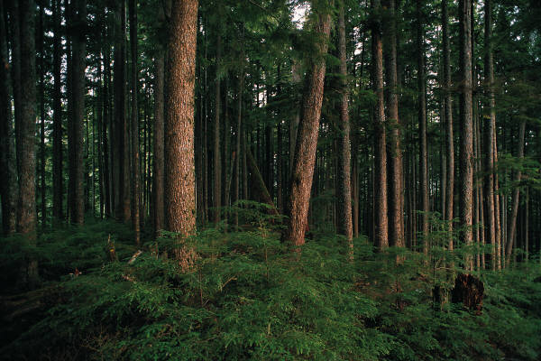
Definitions: Region

Slide 20
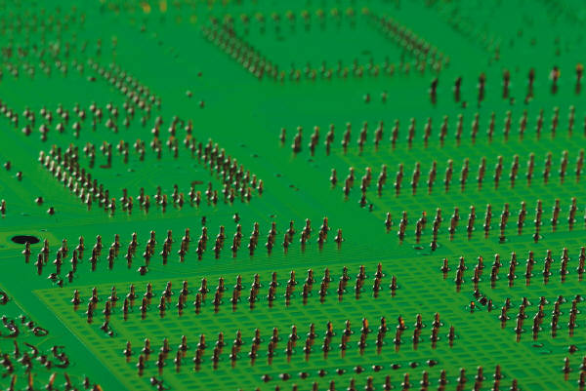
Definitions: Region

Slide 21
Definitions: Location
An arbitrary point in region R
s=(s1,s2)
“x” and “y” coordinates

Slide 22
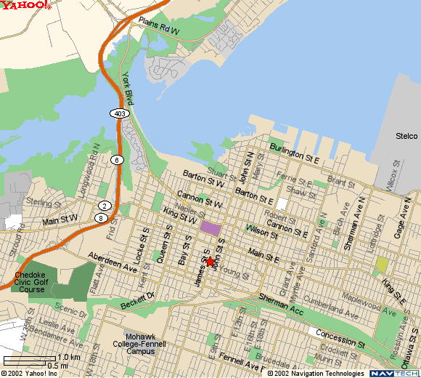
Definitions: Attribute
A characteristic of interest about a location

Slide 23
Definitions: Observation
A location for which one or more attributes have been measured
Y=(y₁,y₂,…,y_{n})

Slide 24
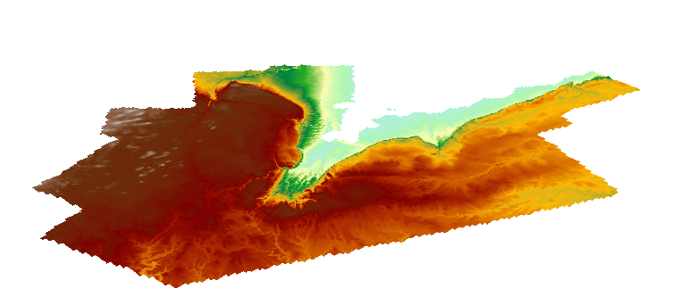
Definitions: First Order Effects
Large scale variation

Slide 25
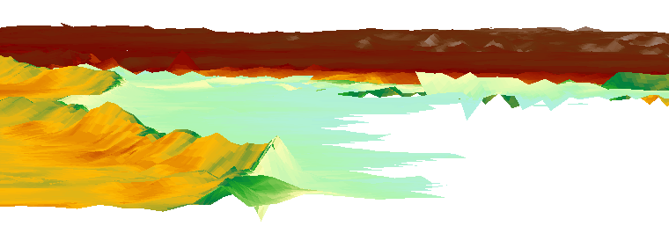
Definitions: Second Order Effects
Small scale variation

Slide 26
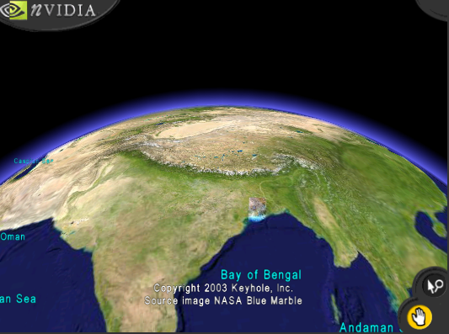
Definitions: Large Scale Variation

Slide 27
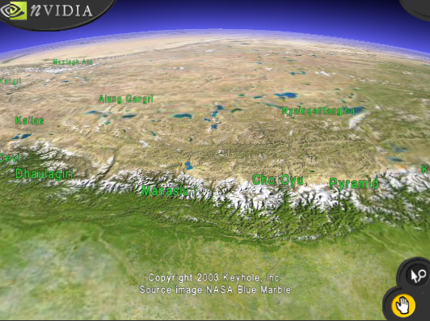
Definitions: Small Scale Variation

Slide 28
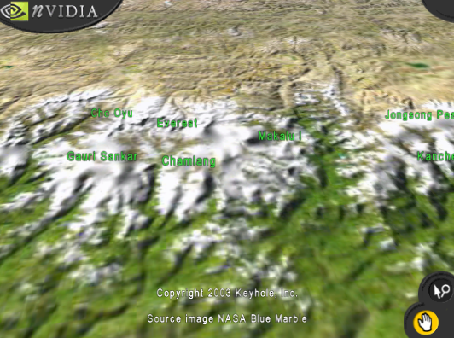
Definitions: Small Scale Variation

Slide 29
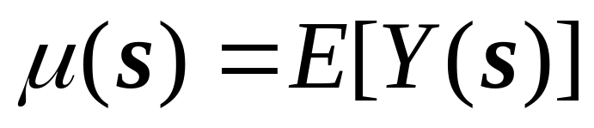
First Order Effects
Expected value of Y at s
(systematic, deterministic)

Slide 30
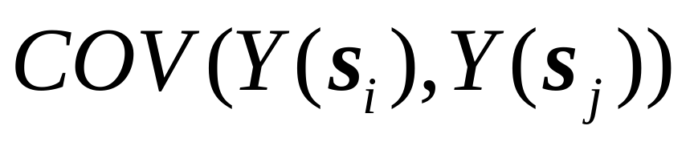
Second Order Effects
Covariance between of Y(s_{i}) and Y(s_{j})
(independent, unpredictable? dependent, deterministic?)

Slide 31
Visualizing Spatially Continuous Data
Symbol maps
Proportional symbol maps
Indicator maps

Slide 32

Visualization: Symbol Map
(Walker Lake)
0
5

Slide 33
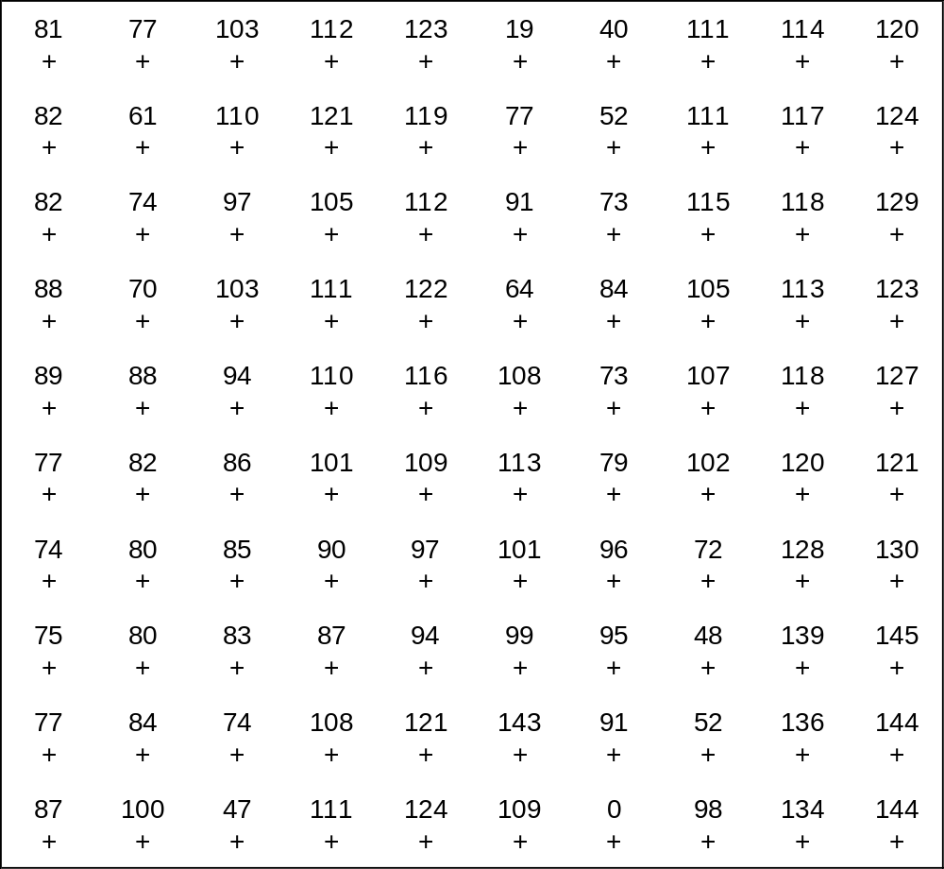
Visualization: Symbol map w/labels

Slide 34

Visualization: Indicator Maps
V<15 ppm
V≥15 ppm

Slide 35

Visualization: Indicator Maps
V<30 ppm
V≥30 ppm

Slide 36

Visualization: Indicator Maps
V<45 ppm
V≥45 ppm

Slide 37
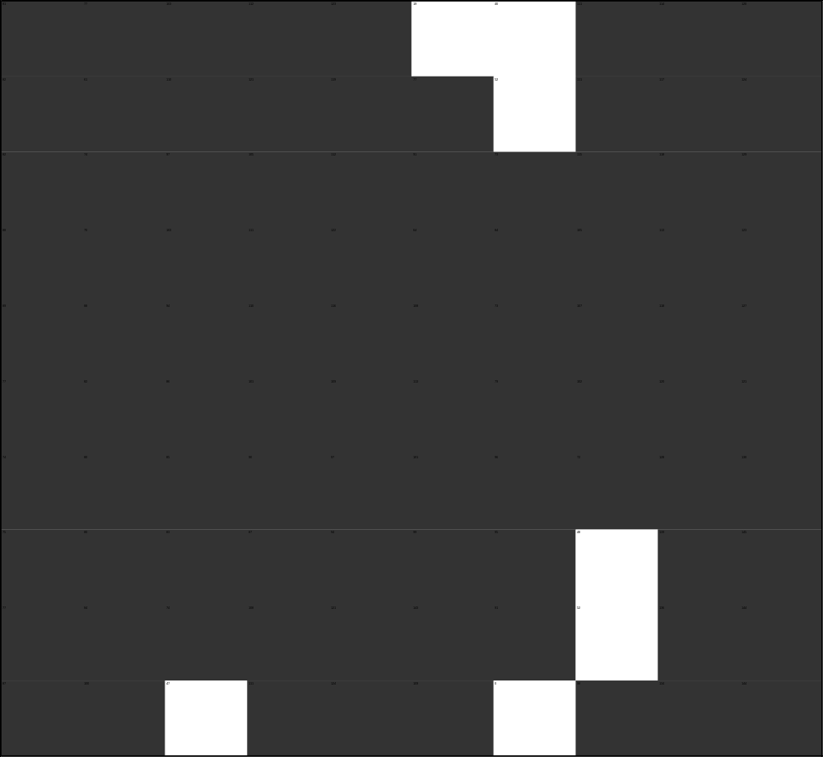
Visualization: Indicator Maps
V<60 ppm
V≥60 ppm

Slide 38

Visualization: Indicator Maps
V<75 ppm
V≥75 ppm

Slide 39
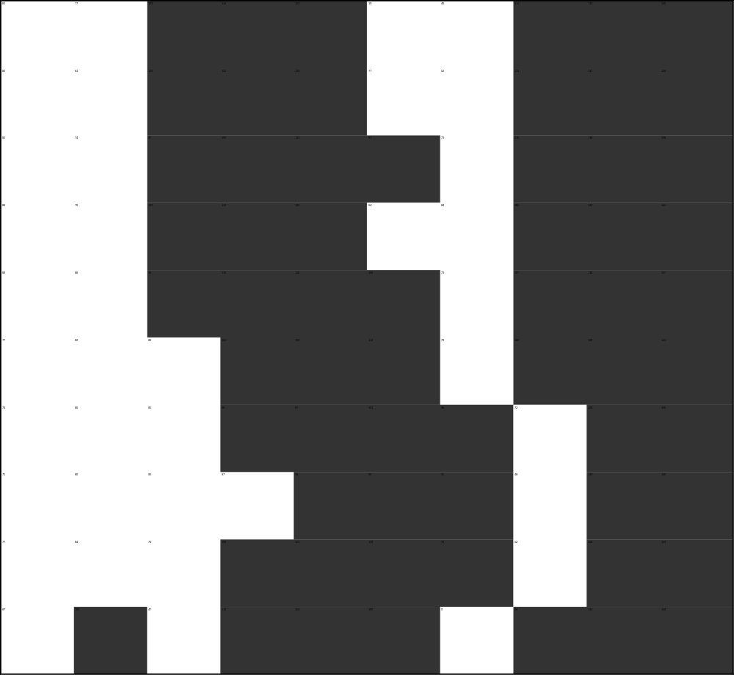
Visualization: Indicator Maps
V<90 ppm
V≥90 ppm

Slide 40

Visualization: Indicator Maps
V<105 ppm
V≥105 ppm

Slide 41
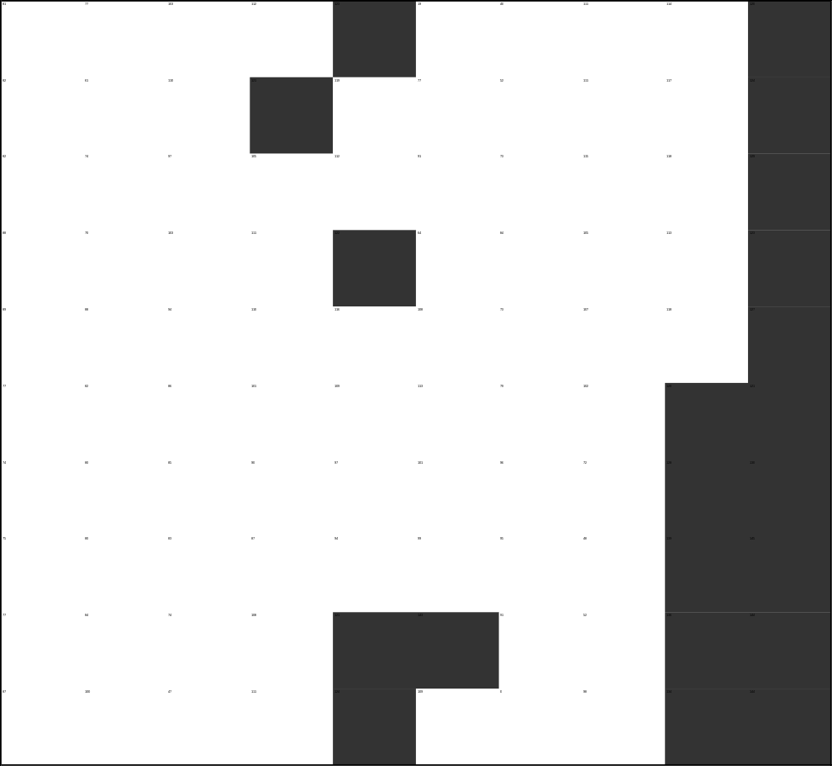
Visualization: Indicator Maps
V<120 ppm
V≥120 ppm

Slide 42

Visualization: Indicator Maps
V<135 ppm
V≥135 ppm

Slide 43
Visualization: Indicator Maps
V<15 ppm V≥15 ppm
V<30 ppm V≥30 ppm
V<45 ppm V≥45 ppm
V<60 ppm V≥60 ppm
V<75 ppm V≥75 ppm
V<90 ppm V≥90 ppm
V<105 ppm V≥105 ppm
V<120 ppm V≥120 ppm
V<135 ppm V≥135 ppm

Slide 44
Visualization: Grayscale map

Slide 45
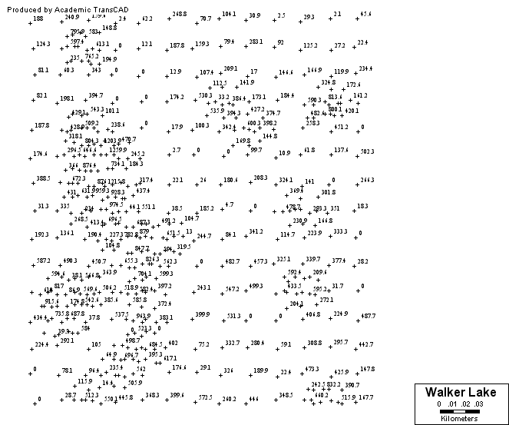
Visualization: Symbol Map w/labels

Slide 46
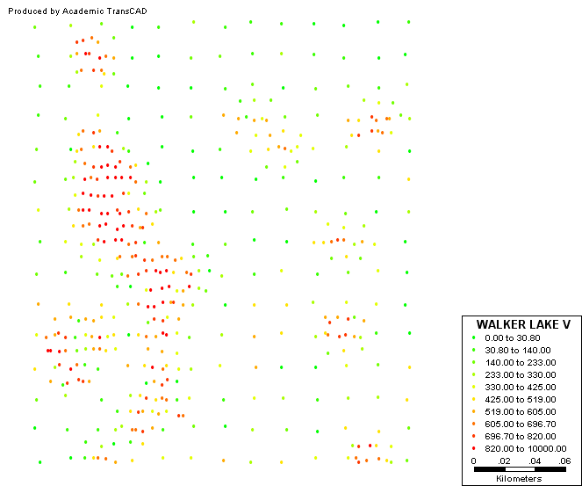
Visualization: Symbol Map w/colors

Slide 47
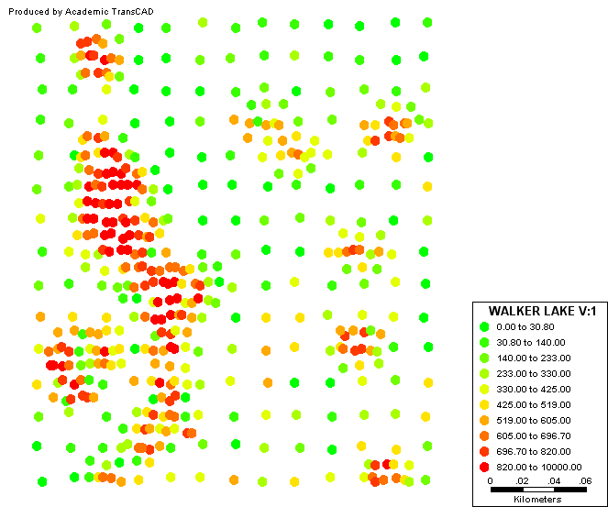
Visualization: Symbol Map w/colors

Slide 48
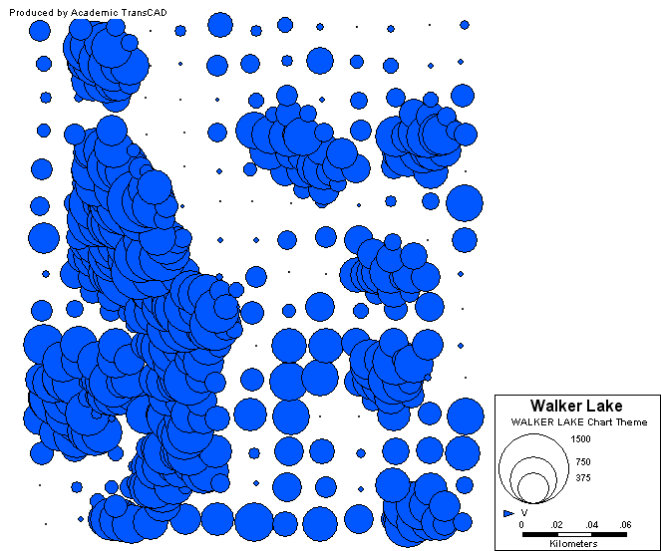
Visualization: Proportional Symbol Map

Slide 49
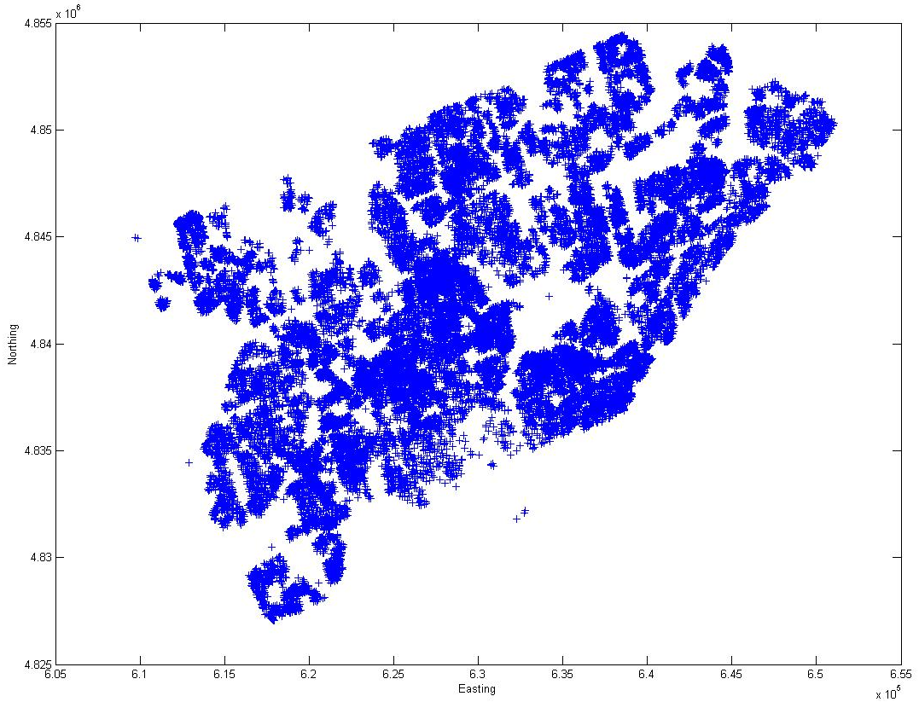
Visualization: Symbol Map
Notes:
Symbol maps are very simple…what are they good for? Consider this map…can you guess what this map is showing? (Houses sold in Toronto in 2001-03) What about the points down there…floating in the lake? Potentially the location was coded with errors. Check map, and show that these houses are indeed on dry land, in one of the islands.
In other cases, symbol maps are extremely useful to reveal obvious errors in the locations of the data.
Also, it is worth checking low values surrounded by high values or vice-versa, as this may indicate measurement errors.

Slide 50
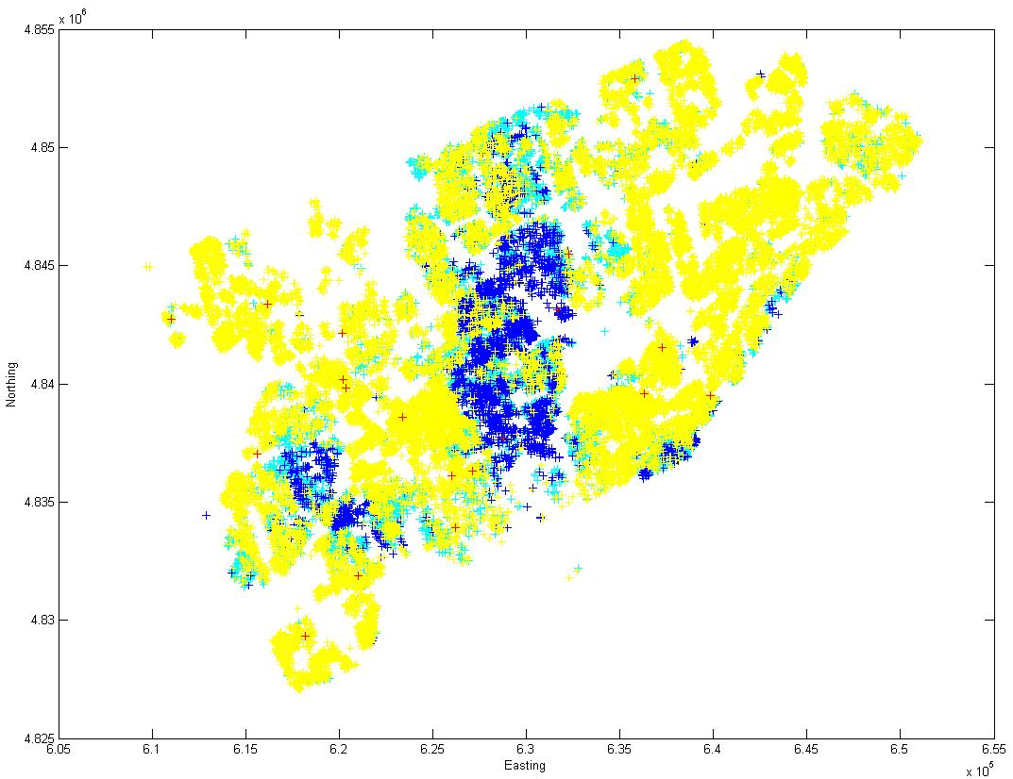
Visualization: Symbol Map w/colors

Slide 51
Visualization
Irregularly spaced observations
  Indicator Maps?
  Grayscale maps?

Slide 52
Exploration: Average (Large Area)

Slide 53
Exploration: Averages at Different Scales
n observations
1 observation

Slide 54
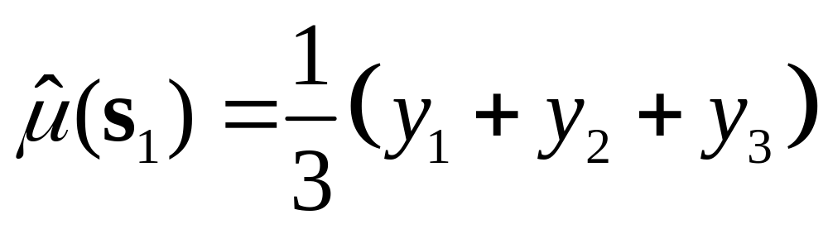
Exploration: Moving Averages
Three-point spatial moving average
2
1
3

Slide 55
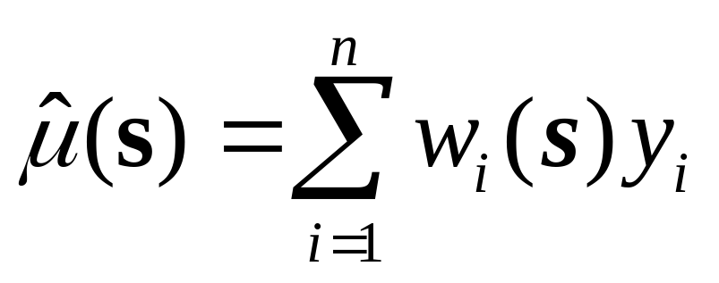
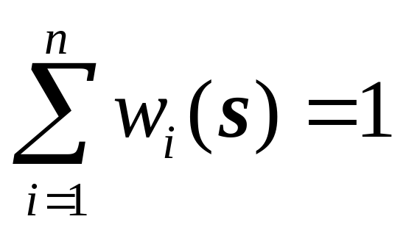
Exploration: Moving Averages

Slide 56
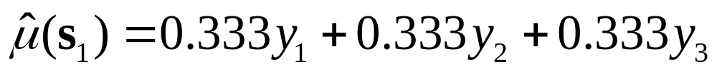
Exploration: Moving Averages

Slide 57
Exploration: Moving Averages

Slide 58
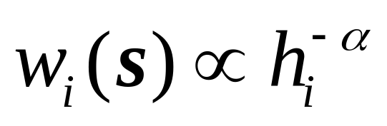
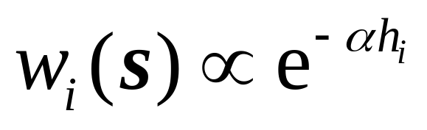
Exploration: Moving Averages
M

Slide 59
Exploration: Kernel Estimation
Kernel function
s
s_{i}
h_{i}
τ

Slide 60
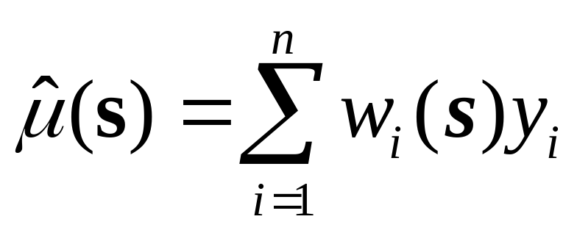
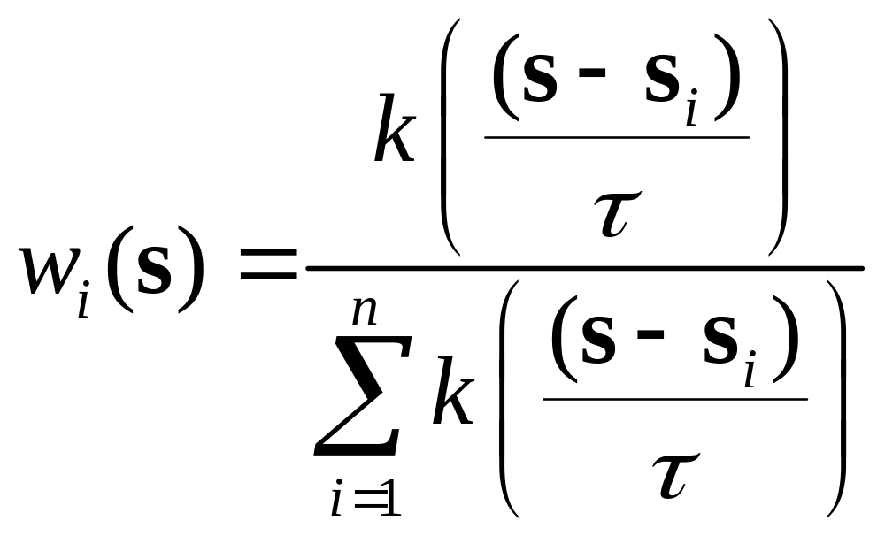
Exploration: Kernel Estimation

Slide 61
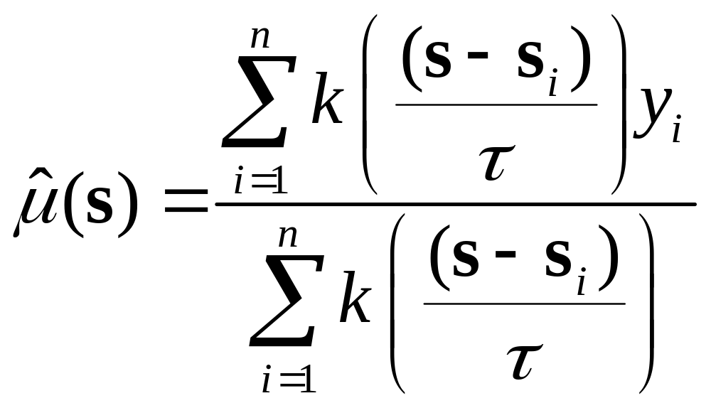
Exploration: Kernel Estimation

Slide 62
Exploration: Tessellations
The objective is to produce “tiles”

Slide 63
Tessellations: Delaunay Triangulation
2
Triangulated Irregular Network (TIN)
Triangles are as close to equilateral as possible
1
3
6
4
5

Slide 64
Tessellations: Voronoi Polygons
2
Areas of Influence
1
3
6
4
5

Slide 65
Tessellations: Delaunay Triangulation
2
1
3
6
4
5

Slide 66
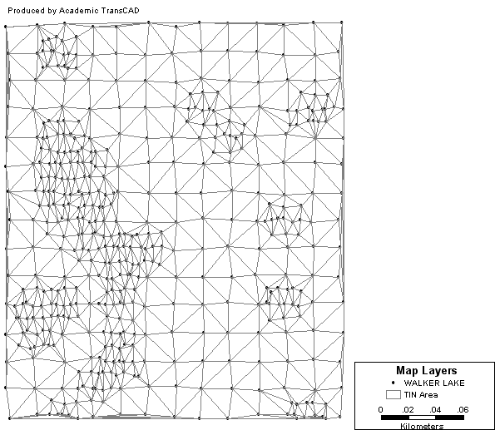
Exploration: Delaunay Triangulation

Slide 67
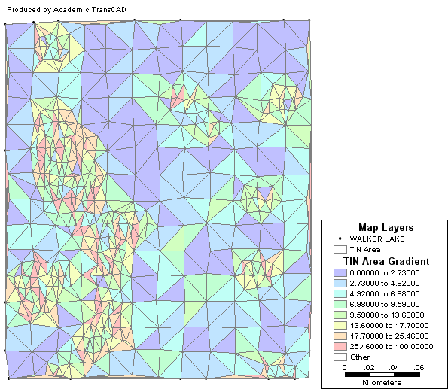
Exploration: Delaunay Triangulation

Slide 68
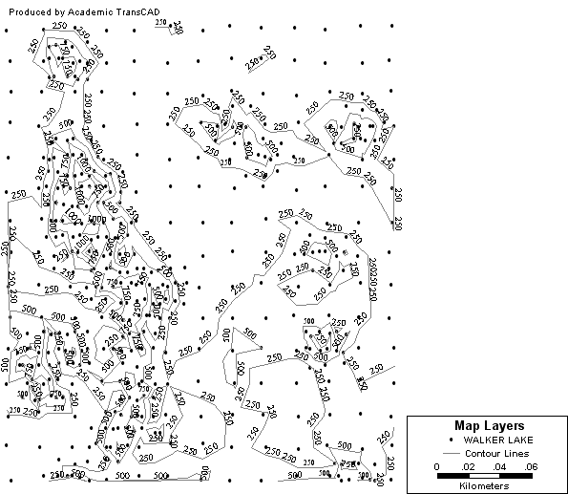
Exploration: Contours

Slide 69
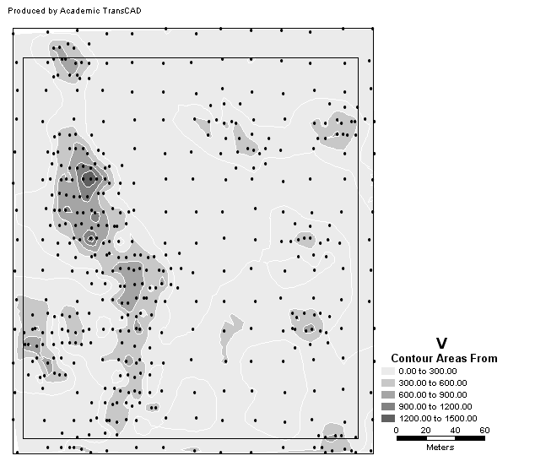
Exploration: Contour Areas

Slide 70
Visualization/Exploration
First order effects, large scale variation
What about small scale variation?

Slide 71
Next…
Exploring second order effects
  Covariogram and variogram
Modeling spatially continuous data

